Slide 1


Improving Citi Bike Services by Comparative Analytics
Apurva Patkeshwar
Bhaskar Gurram
Pranav Chaphekar

Slide 2
Abstract
This project analyzes the NYC taxi and Citi Bike dataset using Hadoop, Pig and Spark
People have to walk to Citi Bike stations to get a ride and if the stations are too far, people don’t prefer using it. Our project targets at improving the usage of Citi Bikes, by analyzing millions of taxi rides to guide users which mode of transport to choose
We also suggest places where new Citi Bike stations can be added

Slide 3
Motivation
Who are the users of this analytic? Who will benefit from this analytic?
Residents of New York City
Citi Bike management group
Why is this analytic important?
Citi Bike group will be able to improve the availability of services as we have identified areas where new stations can be installed
Commuters are unaware that in many scenarios Citi Bikes will help them to reach their destination faster as compared to taxis. Our analytic will help them to choose Citi Bike over Taxis when the Citi Bikes are a better alternative

Slide 4
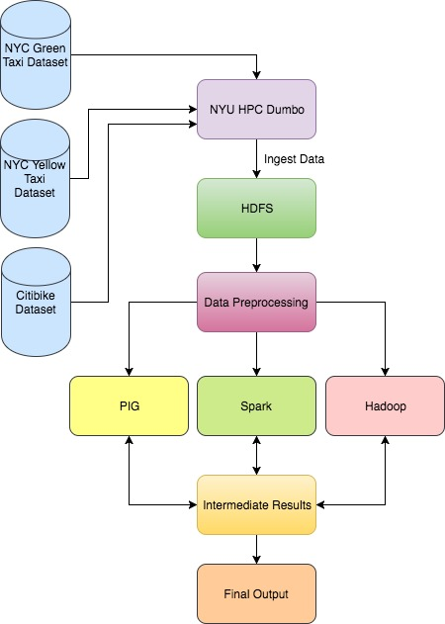
Design diagram
Platform on which we ran the analytic
NYU HPC Dumbo Cluster
Cloudera Quickstart VM

Slide 5
Results
K-Means Centroids of NYC Taxi Data
By applying K-means algorithm on the NYC Taxi Data, we found the top 200 locations with most pickups
We later found the centroids which does not have any Citi Bike docks within 1.2 miles range
These are the hotspots for taxi pickups and the Citi Bike owners can target these areas to install new docks

Slide 6
Results
Current Citi Bike docks
Places for new Citi Bike docks

Slide 7
Results
Citi Bike Pickup Heatmap
Citi Bike Drop-off Heatmap

Slide 8
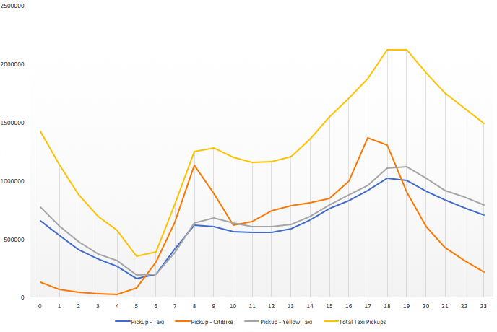
Pickups of NYC Taxis and Citi Bikes

Slide 9
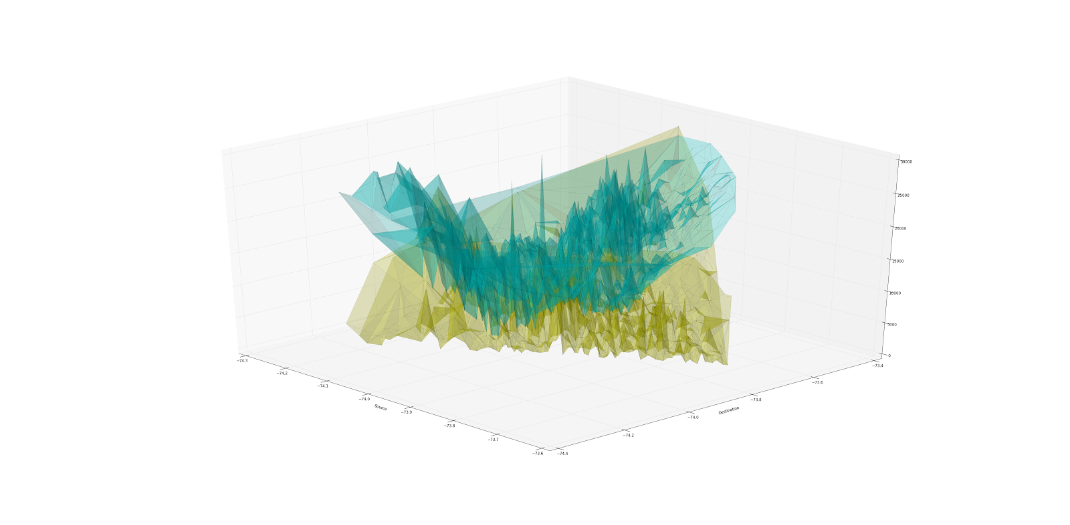
Citi Bike vs Yellow Taxi trip time
A Comparison of the time taken by NYC yellow taxis and Citi Bikes

Slide 10
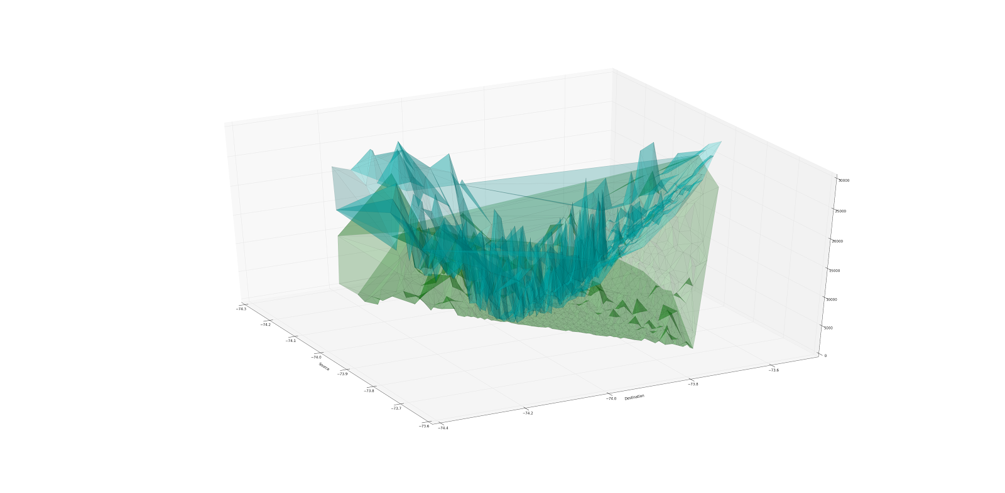
Citi Bike vs Green Taxi trip time
A comparison for the time taken by NYC green taxis and Citi Bikes

Slide 11
Predicting Citi Bike Time
Random Forest Regressor (Number of trees: 10, number of features for each split: 3)
Mean Square Error (insample): 4.8 Mean Square Error (outsample): 6.6

Slide 12
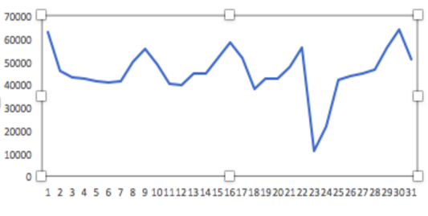
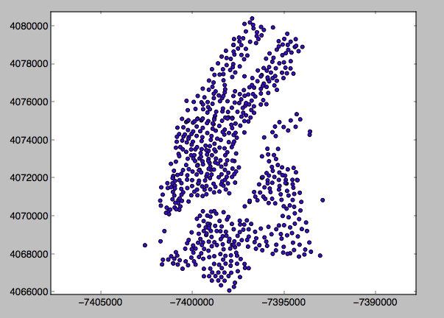
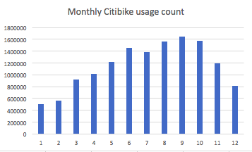
Additional analytics
Understanding NYC using Citi Bike and Yellow and Green Taxi Data

Slide 13
Summary
Our analytic can help the Citi Bike group to improve their services by setting up Citi Bike stations near the Taxi hotspots for pickups
Users can also prefer to go by Citi Bike instead of Taxis sometimes, as in many cases that can be a better alternative taking into consideration the time factor
We can also understand the region better by exhaustively analyzing the Citi Bike and Taxi data, as we feel that it is indicative of the events happening in the region

Slide 14
Obstacles
Analysis using Spark ML Lib was a new concept
Unexpected values and outliers in the data had to be cleaned handled properly

Slide 15
Acknowledgements
We are grateful to thank Prof. Suzanne McIntosh for her help and guidance throughout the project
We would also like to thank NYU HPC cluster for the large scale computation access provided

Slide 16
References
NYC Taxi and Limousine Comission. http://www.nyc.gov/html/tlc/html/about/about.shtml
W. H. Cantrell, and W. A. Davis, “Amplitude modulator utilizing a highQ class-E DC-DC converter”, 2003 IEEE MTT-S Int. Microwave Symp. Dig., vol. 3, pp. 1721-1724, June 2003.
Sun, Huiyu, and Suzanne McIntosh. ”Big data mobile services for New York city taxi riders and drivers.” Mobile Services (MS), 2016 IEEE International Conference on. IEEE, 2016.
Ferreira, Nivan, et al. ”Visual exploration of big spatio-temporal urban data: A study of new york city taxi trips.” IEEE Transactions on Visualization and Computer Graphics 19.12 (2013): 2149-2158.
What 22 Million Rides Tell Us About NYC Bike-Share. https://nextcity.org/daily/entry/citi-bike-new-york-city-bike-share-data
Apache Hadoop MapReduce
Apache Pig
Spark

Slide 17
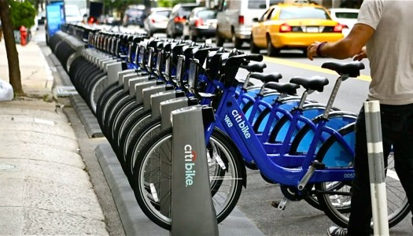
Thank you

